Slide 1
Reduced molecular representations and their role in protein structure prediction
T.W. Barlow, W.G. Richards
Journal of Molecular Structure (Theochem) 398-399 (1997)
Speaker: Chun-Jen Chen
Date: Nov. 10, 2009

Slide 2
Abstract
The technique of nonlinear mapping is shown to permit two-dimensional representations of protein structure. The resulting diagrams retain distance geometry information to a distance matrix root mean square (dmrms) accuracy of about 3.0 A, and in a striking manner maintain the fold and secondary structural features of the three-dimensional entity. By assuming a consistent carbon alpha to carbon alpha distance, we make a further reduction to a one-dimensional angle plot which itself retains distance relationships to an accuracy not appreciably worse than the two-dimensional plot.
115/11/07

Slide 3
Abstract
It is possible to go from one dimension to two, and hence to three without complications arising from chirality by using a sign convention and inspecting the overall three-dimensional structure which may need inverting. There are numerous possible applications of this approach but the hope is that it will provide a basis for going from a one-dimensional gene sequence to a tertiary protein structure.
115/11/07

Slide 4
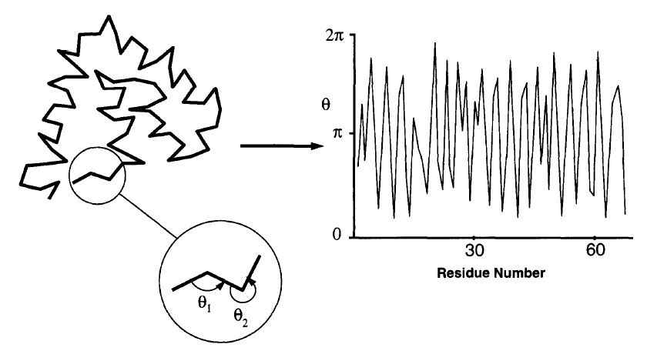
Introduction

Slide 5
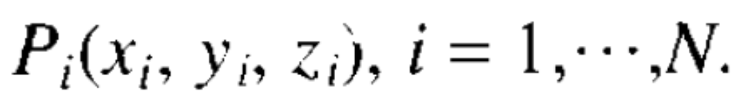
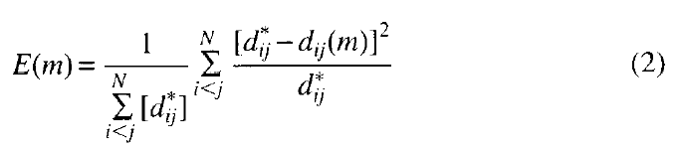
Methods

Slide 6
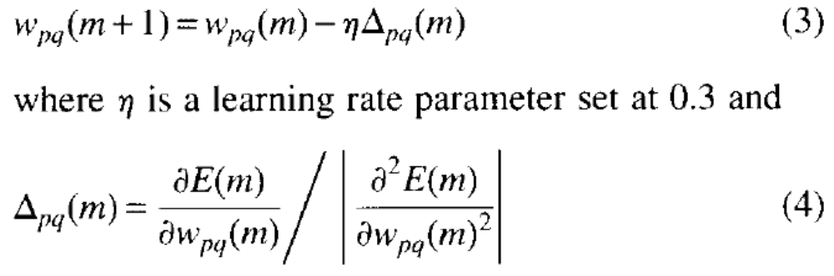
Methods
This error can be minimized by an iterative process. In Eq. (2), m labels the iteration number. The two-dimensional vectors, W_{i} are modified to minimize the error by a steepest descent method. The new components of W_{p} are given by

Slide 7
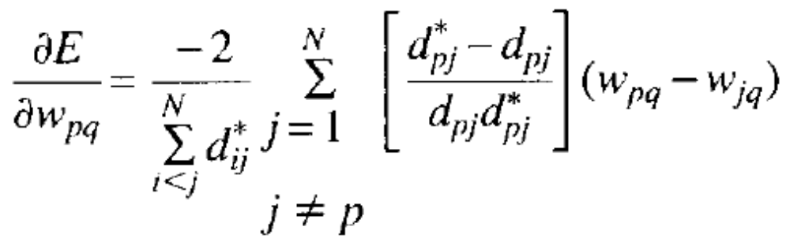
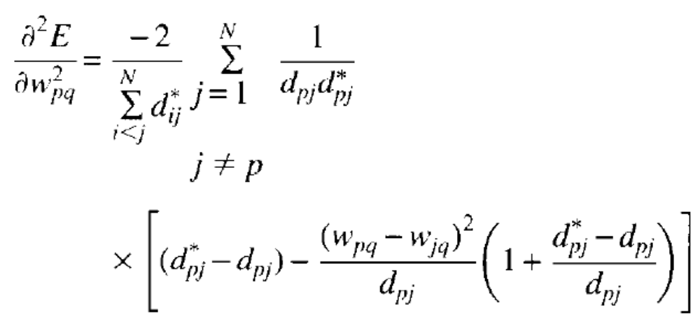

Slide 8
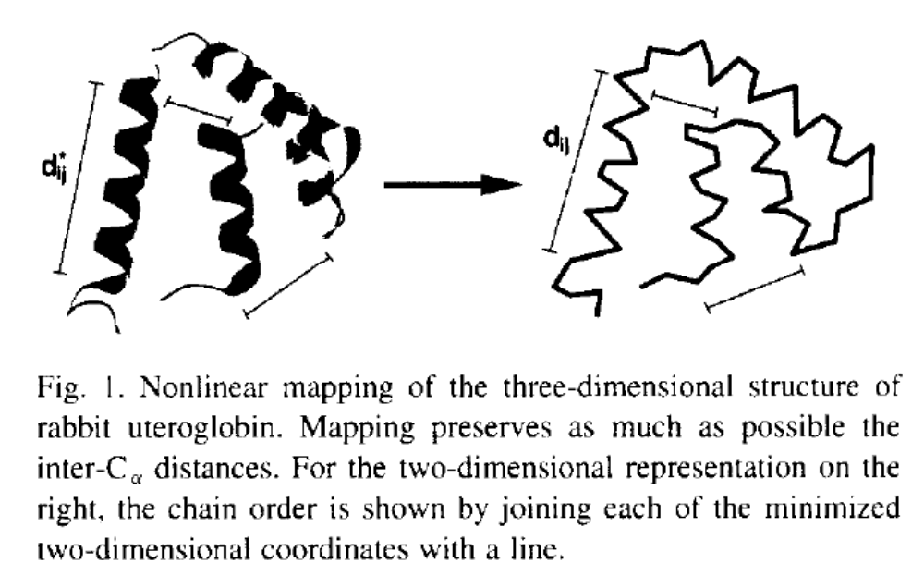
Example

Slide 9
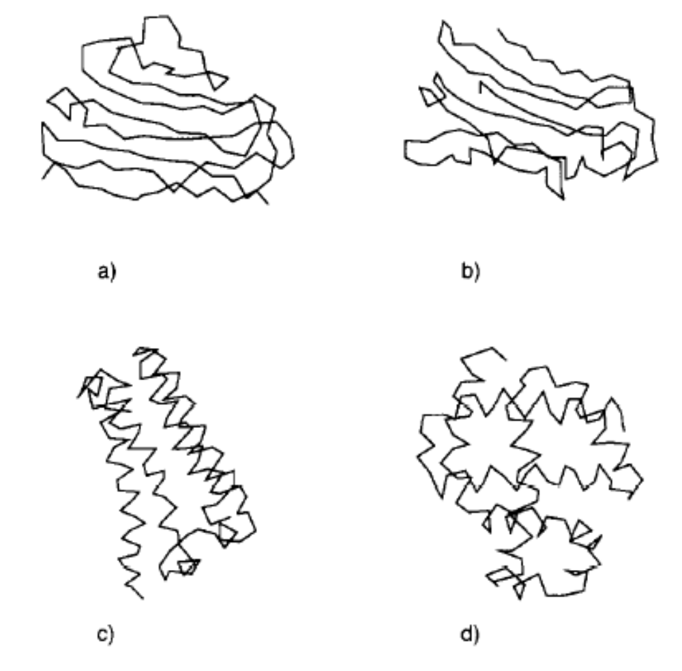
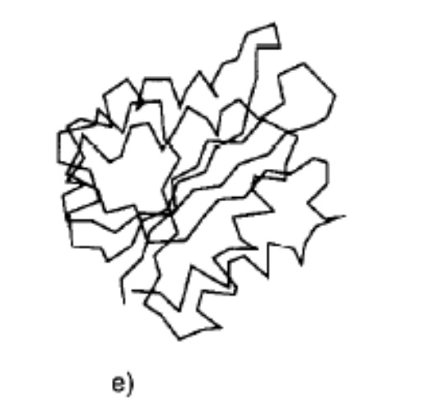
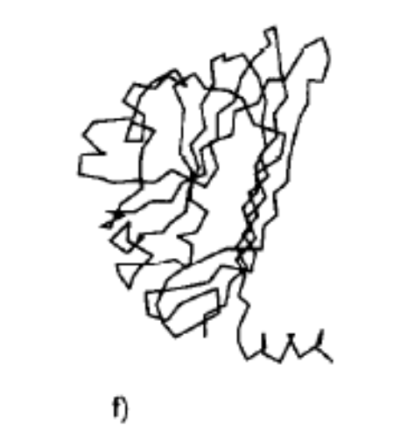
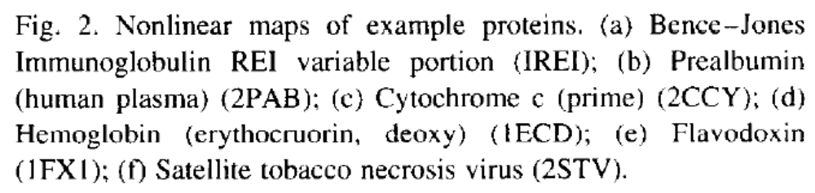

Slide 10
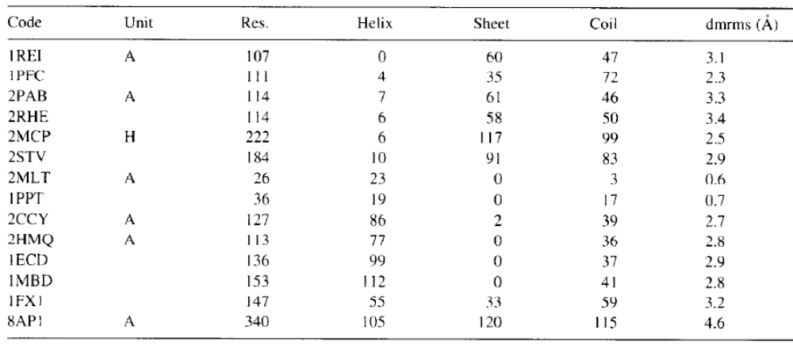
Experimental Results

Slide 11
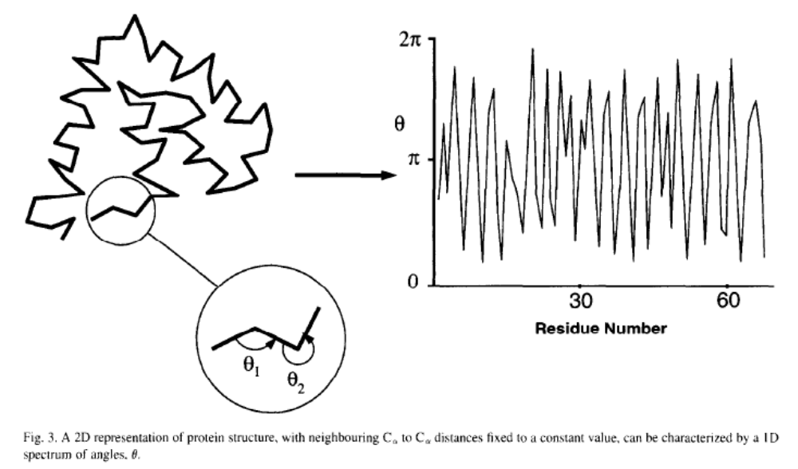

Slide 12
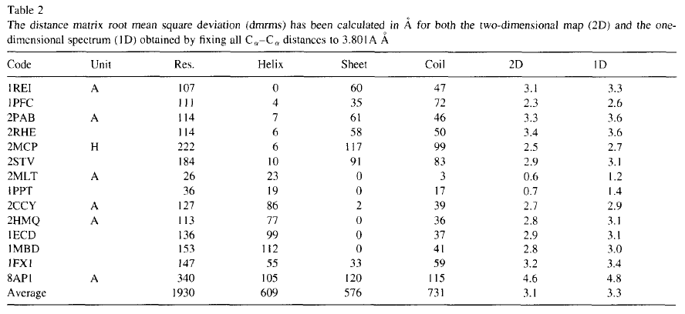
Experimental Results

Slide 13
Conclusion
We have shown that there are two- and one-dimensional representations of protein structure that retain distance information to an acceptable degree. It is also possible to move in both directions between 1D, 2D and 3D representations so that the 1D diagram can summarize tertiary structures.

